Slide 1
AI-Derma System Analysis
An AI-powered dermatology system combining image classification with a rule-based questionnaire to diagnose skin diseases.

Slide 2
Agenda
Problem Statement
System Overview
Objectives
Hybrid Workflow
Targeted Disease & Categorization
Knowledge Base
Data Flow diagram
ER diagram
Sequence diagram
Use Case diagram

Slide 3
Problem Statement
Widespread burden: Skin diseases affect billions worldwide (4.69 billion new cases in 2021) and rank among the top 10 causes of disability .
Diagnosis challenges: Accurate diagnosis often requires a dermatologist. Many regions have few specialists, delaying care .
Similarity of symptoms: Conditions can look alike; misdiagnosis is common (especially by non-experts) .
Early detection is crucial (e.g. melanoma 5-year survival 99% if early vs 20% after metastasis ).

Slide 4
System Overview
AI-Derma is a hybrid diagnostic system that detects skin diseases using CNN image analysis supported by a rule-based expert system. If AI confidence is low, users answer symptom questions, which are matched against a medical rule database to infer a likely diagnosis. The system stores user data, images, predictions, and history, offering a complete dermatology support workflow.

Slide 5
Objectives
Mobile AI screening: Build a user-friendly app that analyzes photos of skin lesions and identifies the condition.
Accurate classification: Employ machine learning to predict the skin disease, providing a confidence score for each result.
User guidance: Deliver clear explanations and self-care tips for the detected condition, and advise when to seek medical attention.
Early detection: Empower users to catch serious issues early (e.g. spotting melanoma sooner, which greatly improves survival ).
Improved access: Extend basic dermatology support to remote or underserved communities, aligning with WHO recommendations for digital health tools

Slide 6
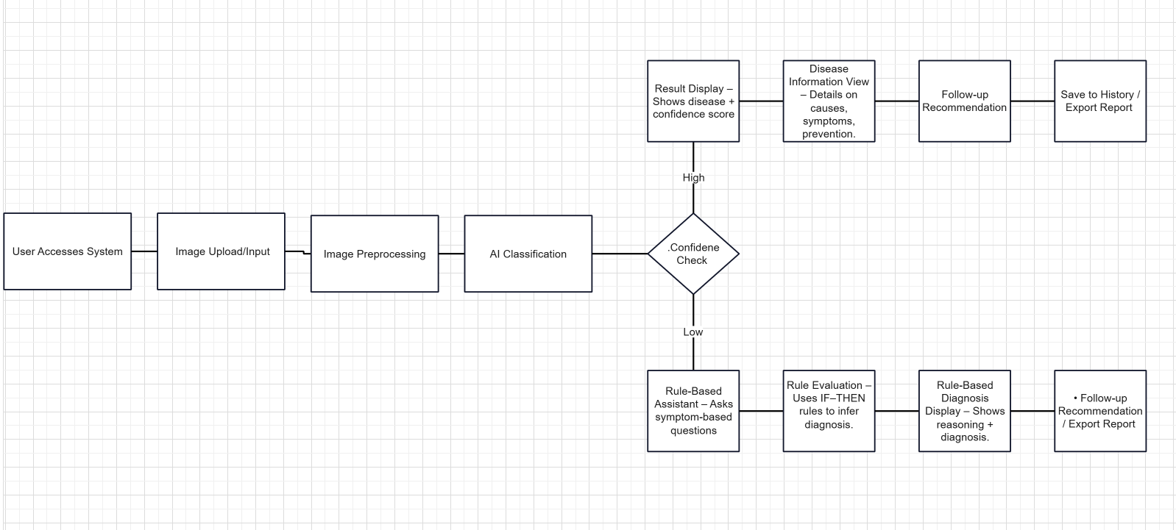
Workflow

Slide 7
Disease Categorization
Hybrid (AI + Rule) :Cases where both the image and a few symptom-based questions are needed for better accuracy. The AI suggests possible diseases, and the rule assistant uses symptoms to differentiate between them.
AI-Detected (Image-Based Only) : Diseases that are handled by the image model only because no symptom questions were defined for them or they don’t require non-visual inputs. This does NOT mean the AI is 100% certain — just that there are no rule questions linked to these diseases.
Rule-Detected (Symptom-Based Only) :Conditions that cannot be diagnosed from an image alone and require non-visual symptoms.

Slide 8
Targeted Diseases
1. Acne : Clogged pores causing pimples, blackheads, and cysts on the face, chest, or back.
( Hybrid )
2.Psoriasis :Chronic autoimmune skin condition with red patches and silvery scales, sometimes with joint pain.
( Hybrid )
3. Eczema (Atopic Dermatitis) : Inflamed, itchy skin with dryness, blisters, and cracking, often triggered by irritants or allergens.
( Hybrid )
4. Ichthyosis : Hereditary disorder causing extremely dry, fish-scale-like skin, usually starting in childhood.
( Questions )
5. Meningitis Rash : A medical emergency with fever, severe headache, stiff neck, and a sudden purpuric rash.
( Questions )
6. Measles (Rubeola) : Highly contagious viral infection causing fever, cough, runny nose, and a spreading red rash with Koplik spots.
( Questions )

Slide 9
Targeted Diseases ( Cont. )
7. Scarlet Fever : Bacterial infection causing fever, sore throat, strawberry tongue, and a sandpaper-like rash.
( Questions )
8. Insect Bites & Stings : Localized reaction after an insect bite with redness, swelling, itching, or pain.
( Questions )
9. Warts (HPV) : Rough skin growths caused by human papillomavirus, often containing small black dots. ( Hybrid )
10. Fungal Infections (Tinea / Ringworm) : A contagious fungal infection causing red, itchy, circular scaly patches on skin, hair, or nails.
( AI )
11. Melanoma : The most dangerous type of skin cancer — rapidly spreading pigment-cell tumor that needs early detection.
( AI )

Slide 10
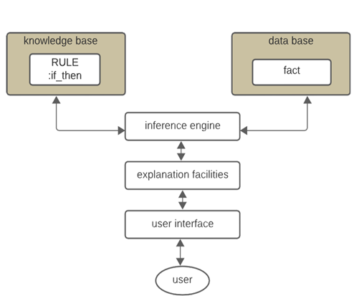
Knowledge Base ( Rule-Based System )
Basic Structure Of Rule-Based

Slide 11
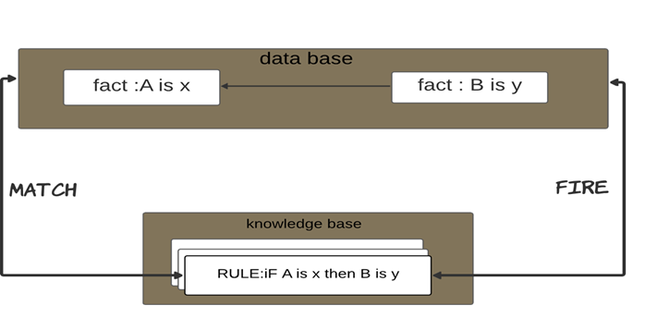
Knowledge Base ( Rule-Based System )
The inference engine cycle via a match-fire procedure

Slide 12
Knowledge Base (Symptom-Based Only )
Skin Rashes WITHOUT Fever
includes skin conditions not associated with fever. Each condition has a unique symptom pattern.
2. Skin Rashes WITH Fever
deals with skin rashes accompanied by systemic symptoms such as fever, sore throat, or headache.
3. Skin Infections
includes localized or viral infections affecting the skin.

Slide 13
Skin Rashes WITHOUT Fever
Disease | Rule | Facts
Psoriasis | @Rule(AND( Psoriasis(red_patches = True), Psoriasis(white_silvery_scales = True), OR(Psoriasis(nail_pitting = True), Psoriasis(joint_pain = True)) )) | red patches on skin white / silvery scales covering patches nail pitting OR joint pain (possible psoriatic arthritis)

Slide 14
Skin Rashes WITHOUT Fever
Disease | Rule | Facts
Eczema (Atopic Dermatitis) | @Rule(AND( Eczema(small_blisters_may_ooze = True), Eczema(intense_itching = True), Eczema(skin_thickened_or_cracked = True) )) | small blisters that may ooze intense itching (often worse at night) skin becomes thickened / cracked over time often linked to irritants or allergens

Slide 15
Skin Rashes WITHOUT Fever
Disease | Rule | Facts
Acne | @Rule(AND( Acne(blackheads_or_whiteheads = True), OR(Acne(inflamed_pimples = True), Acne(oily_skin_with_cysts = True)) )) | blackheads / whiteheads / papules / pustules or deeper cysts oily skin; typical on face/chest/back possible scarring in severe cases

Slide 16
Skin Rashes WITHOUT Fever
Disease | Rule | Facts
Ichthyosis | @Rule(AND( Ichthyosis(extremely_dry_skin = True), Ichthyosis(fish_like_scales = True), Ichthyosis(onset_childhood = True) )) | extreme dryness and fish-scale like scaling typical childhood onset chronic, worse in cold climates

Slide 17
Skin Rashes WITH Fever
Disease | Rule | Facts
Meningitis | @Rule(AND( Meningitis(severe_headache = True), Meningitis(neck_stiffness = True), Meningitis(fever = True), Meningitis(altered_consciousness_or_confusion = POSSIBLE), Meningitis(sudden_skin_rash = True) )) | severe headache + neck stiffness fever, vomiting, altered consciousness possible sudden skin rash may appear

Slide 18
Skin Rashes WITH Fever
Disease | Rule | Facts
Measles | @Rule(AND( Measles(cough = True), Measles(runny_nose = True), Measles(fever = True), Measles(koplik_spots_in_mouth = True), Measles(spreading_rash_after_respiratory = True) )) | cough, coryza (runny nose), fever prodrome Koplik spots (small white spots inside mouth) spreading red rash after respiratory symptoms

Slide 19
Skin Rashes WITH Fever
Disease | Rule | Facts
Scarlet Fever | @Rule(AND( ScarletFever(sore_throat = True), ScarletFever(fever = True), ScarletFever(strawberry_tongue = True), ScarletFever(sandpaper_rash = True) )) | sudden sore throat with fever red/swollen (“strawberry”) tongue coarse / sandpaper-like rash (often chest/neck)

Slide 20
Skin Infections
Disease | Rule | Facts
Insect Bite | @Rule(AND( InsectBite(onset_after_bite_or_sting = True), InsectBite(local_redness = True), InsectBite(swelling = True), OR(InsectBite(pain = True), InsectBite(itching = True)) )) | red, swollen, painful or itchy lump at site may have systemic signs in severe allergic reaction

Slide 21
Skin Infections
Disease | Rule | Facts
Warts (HPV) | @Rule(AND( Warts(firm_round_growths = True), Warts(rough_surface = True), Warts(tiny_black_dots = True) )) | firm, rough growths (often hands/feet) tiny black “seed” dots (thrombosed capillaries) caused by HPV; treatable with cryotherapy / topical keratolytics

Slide 22
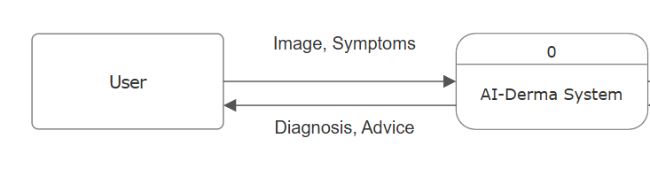
Data Flow Diagram ( DFD )
Context Diagram

Slide 23
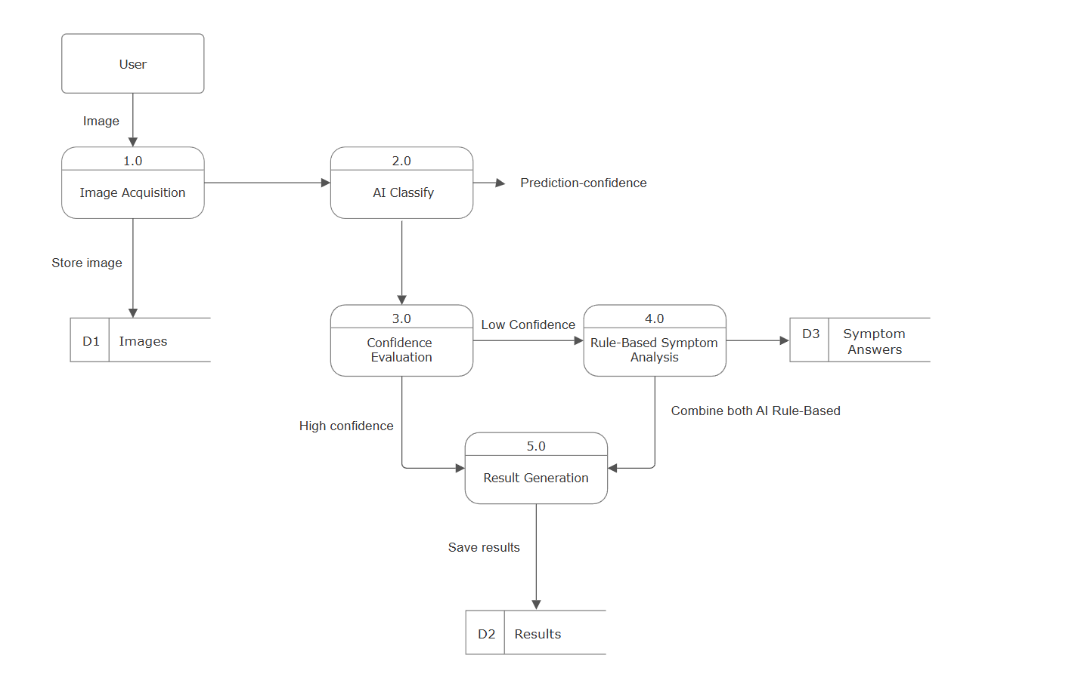
DFD ( Cont. )
Level 1

Slide 24
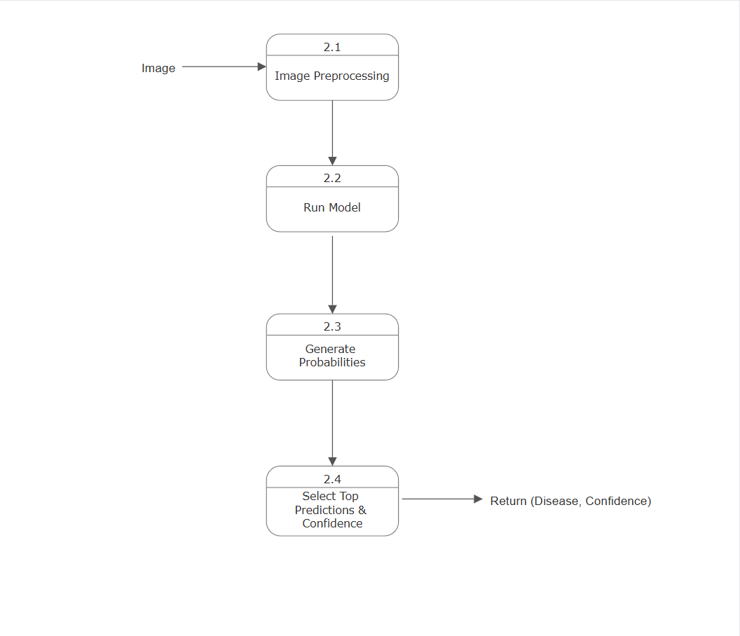
DFD ( Cont. )
Level 2 — Detail for 2.0 AI Classification

Slide 25
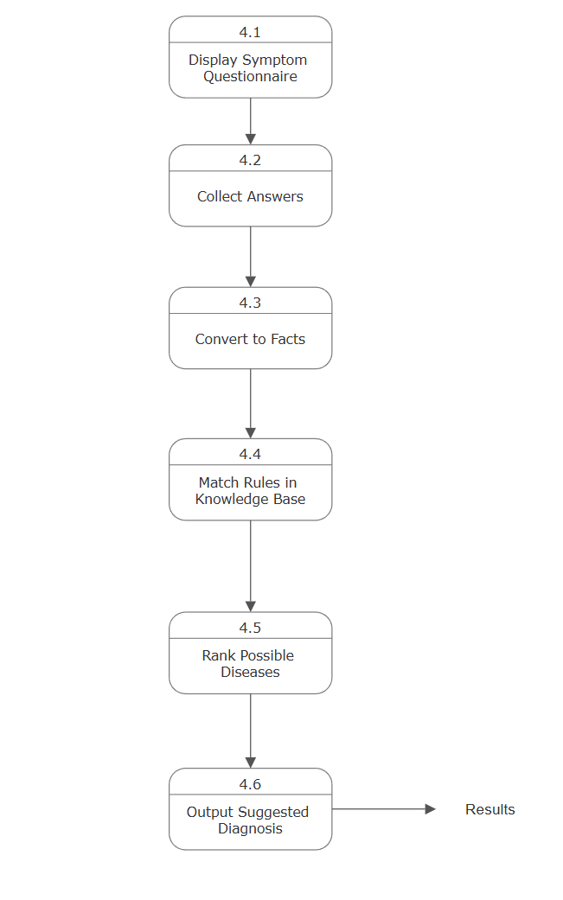
DFD ( Cont. )
Level 2 — Detail for 4.0 Rule-Based Symptom Analysis

Slide 26
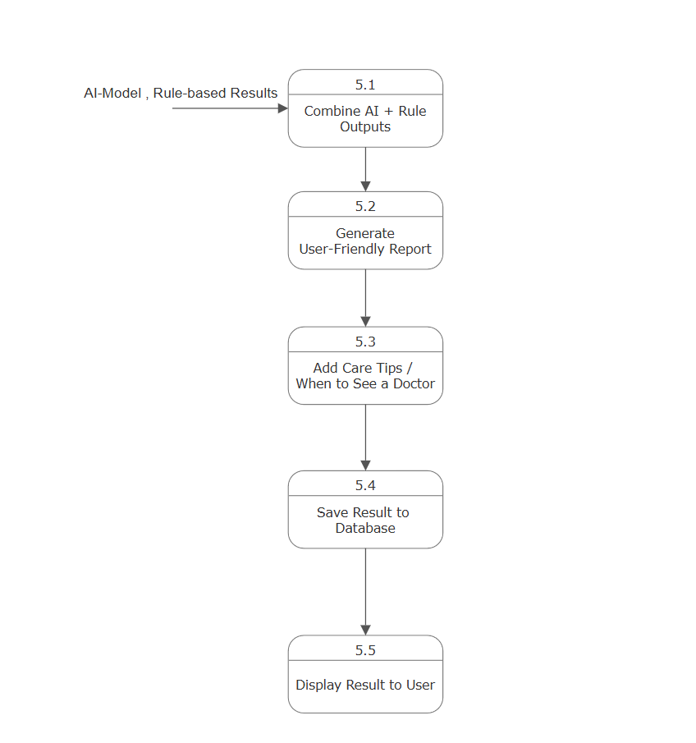
DFD ( Cont. )
Level 2 — Detail for 5.0 Result Generation

Slide 27
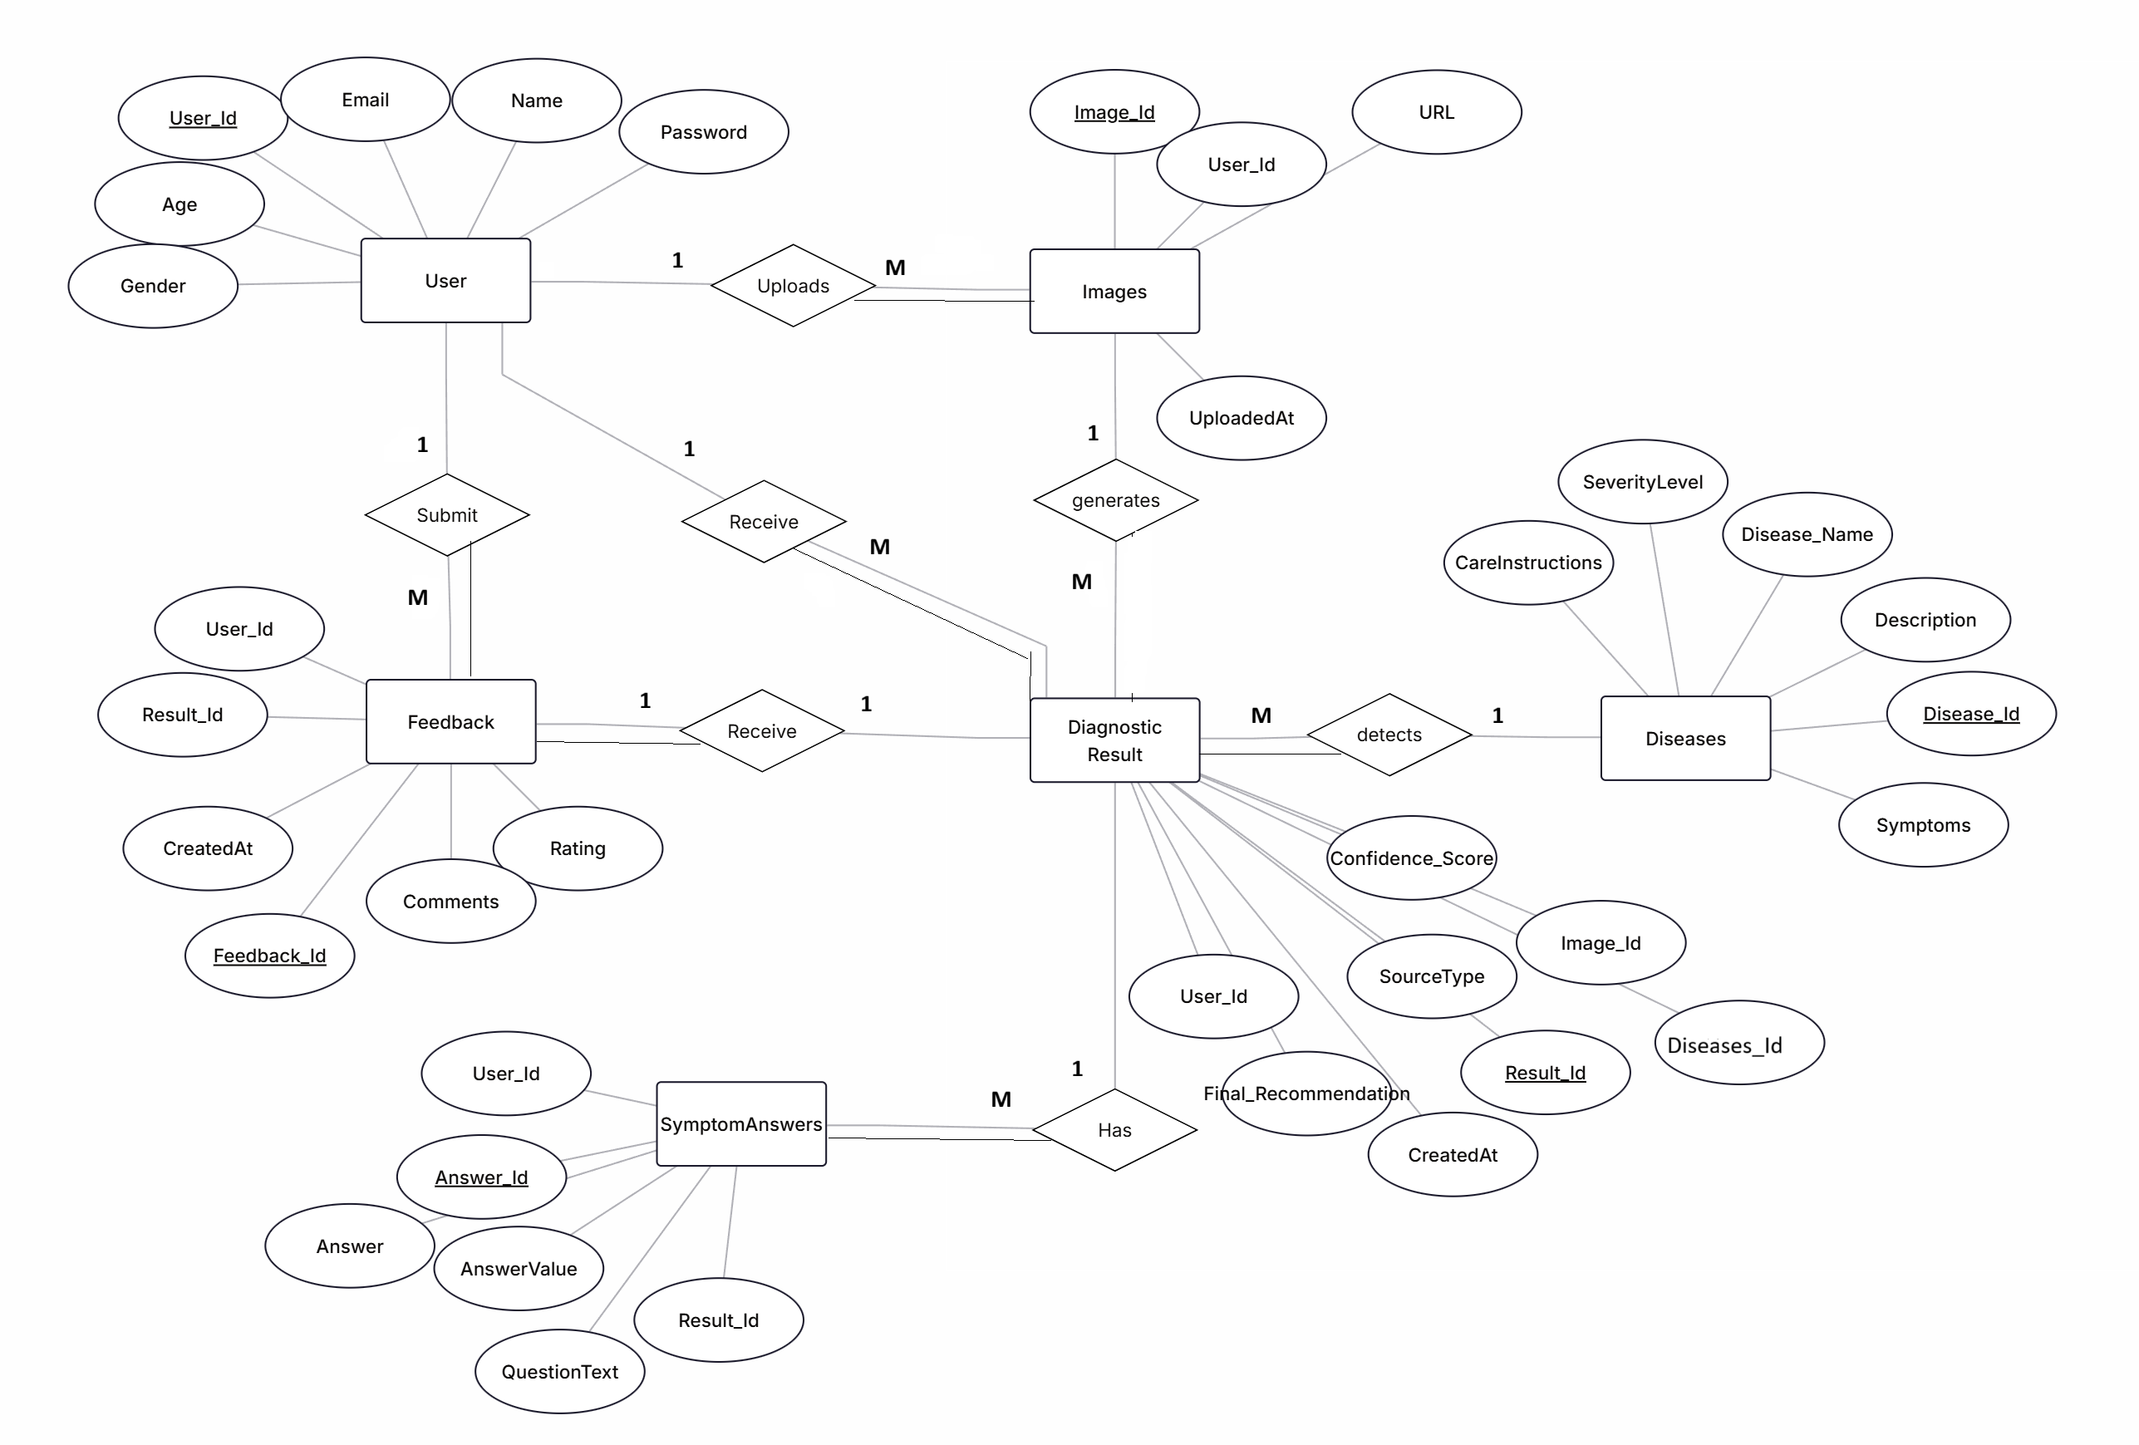
ER Diagram

Slide 28
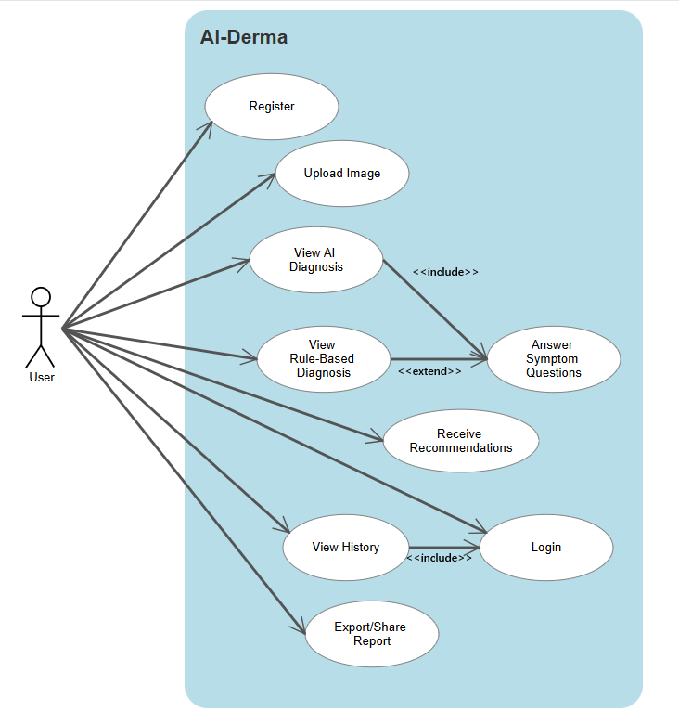
Use Case Diagram

Slide 29
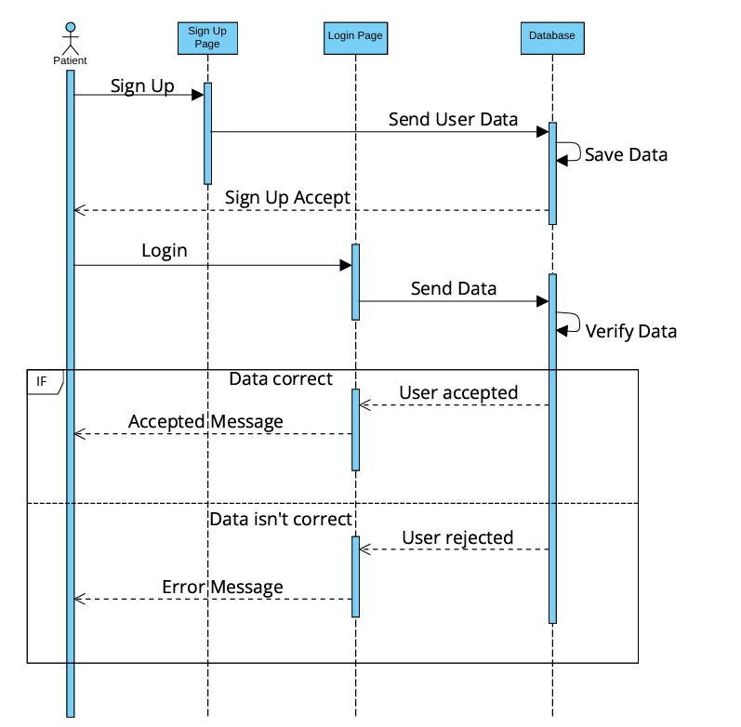
Sequence Diagram
User Login

Slide 30
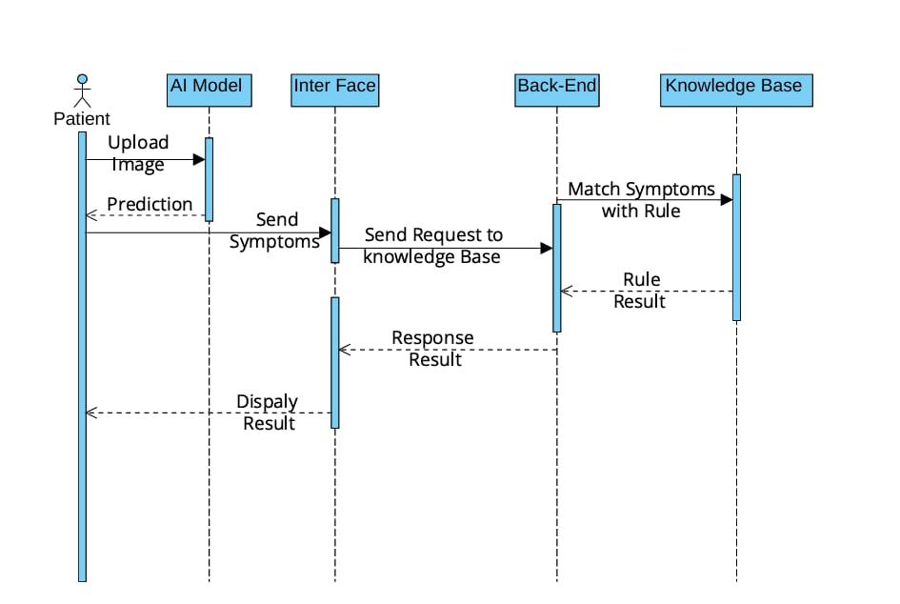
Sequence Diagram

